Slide 1
CUSTOMER PROJECT REVIEW
Employee Name : CHANDRU R
Emp ID : 2116
Joined Date : 10-08-2023 Customer : Platform, ESA & INFRAVIT Current Assignment : SCH Platform Development Reporting Manager : Soumyojit Sen

Slide 2
Completed Tasks
Platform Tasks :
KPI Card: Implement multiple Key Value displays.
Arrow Logic: Reverse functionality: Show a downward arrow when expanded (v) and an upward arrow when collapsed.
Simple Table: Fix pagination issues.
Top Bar: Add a blue top bar for pre-login pages accessible to public users.
Help Desk Enhancements: Implement improvements in the Help Desk functionality.
Transport Object Loading: Load the selected value into the JSON editor within the transport object.
Email Notifications: Implement email notifications for Help Desk activities.
Help Desk "Reported By" Field: Set the default value field to the logged-in user.
Email Notification Details: Include the Help Desk ID along with the subject line in email notifications.

Slide 3
Completed Tasks
CBP Workbench Implementation: Deploy the Workbench on the Interise server.
Help Desk Features: Implement filtering and downloading options for issues in the Help Desk.
Add task reminder notifications for Help Desk tickets.
SCH Rebranding: Rebrand the ESA Landing page for SCH.
Transport Request:
Create a new page for submitting transport requests.
Enhance the existing transport request creation process.
Help Desk Email Inclusion: Ensure that "ESASUPPORT" is included in all Help Desk ticket emails.
Transport History Pages: Create list pages for transport history and transport error logs.

Slide 4
Completed Tasks
ESA Tasks :
Payment List Page Creation: Develop a new page for the payment list.
PO PDF Display: Ensure that the PO PDF file is displayed on the PO item list, GRN, and SES approval pages.
PRD Download and Filtering: Implement download and filtering options for PRD issues.
Embedded Table Download: Add download functionality for the embedded table in the PO item detail.
Terminology Consistency: Ensure consistent terminology throughout the application. Correct the delivery date field data in the PDF.
Excel Download Fields: Address discrepancies in the Excel download fields, ensuring all necessary fields are included.
PDF Download Option: Disable the PDF download option as required.
PO Buyer Page: Fix download and filtering issues on the PO Buyer page.

Slide 5
Completed Tasks
Chat Notifications: Clear all feature and chat count are malfunctioning.
Pages Filter Issue: Date filter is not working on the following pages: PO list, SES list, GRN list, Invoice list, Payment list.
Disable SES Button: Disable the "Create SES" button when all line items' balance quantity is zero for the corresponding activity.
GRN List Issues:
Missing vendor details.
Acknowledgement issues.
Truncated tax description.
PO Collaboration List Page: Add a chart and status dropdown.
Payment History Page: No data is showing in production (Prd) payment history.

Slide 6
Completed Tasks
General Enhancements:
Add hyperlinks.
Configure decimal values.
Hide SES GRN table.
Embedded Table(GRN, Invoice, SES, Payment): Need Item detail embedded table,
Vendor Filter: Replace the checkbox with a search input for "Vendor No & Name" on all relevant pages (VEN0026).
Invoice Embedded Table: Add an embedded invoice table in the GRN history.
DMS Attachment Flag: Add DMS attachment flags for GRN, SES, and Invoice.
E-Mail Template Update: Add a separate table for PO details in notifications.

Slide 7
Completed Tasks
Procurement Team Field: Include a procurement team field in the PO list and PO item list header details.
Vendor & Requested By Fields: Ensure "Vendor Name" and "Requested By" fields are added where needed.
Invoice Mail Notification: Insert PO details in invoice email notifications.
GRN & SES Mail Notifications: Set up "Under Review" email notifications for GRN and SES.
Mail Template Corrections: Apply necessary corrections to existing mail templates.
SES Production Issue: Address SES-related production issues and tasks.
Notification Inbox: Ensure proper functionality of the notification inbox.
Supplier Registration (Bank Account Field): The bank account number field should only accept alphanumeric characters.

Slide 8
Completed Tasks
Infravit Tasks
Duplication Number Validation: Implement duplication number validation through API.
Read-Only for Text Area (QAS): Fix the issue where read-only is not working for text areas in QAS.
Profile Image Issue: Resolve the profile image issue in both dev and QAS environments.
Read-Only for TextBox: Fix the issue where read-only is not working for text boxes.
Material Code Removal: Remove material codes starting with "000000" from all pages in Vendor Connect.

Slide 9
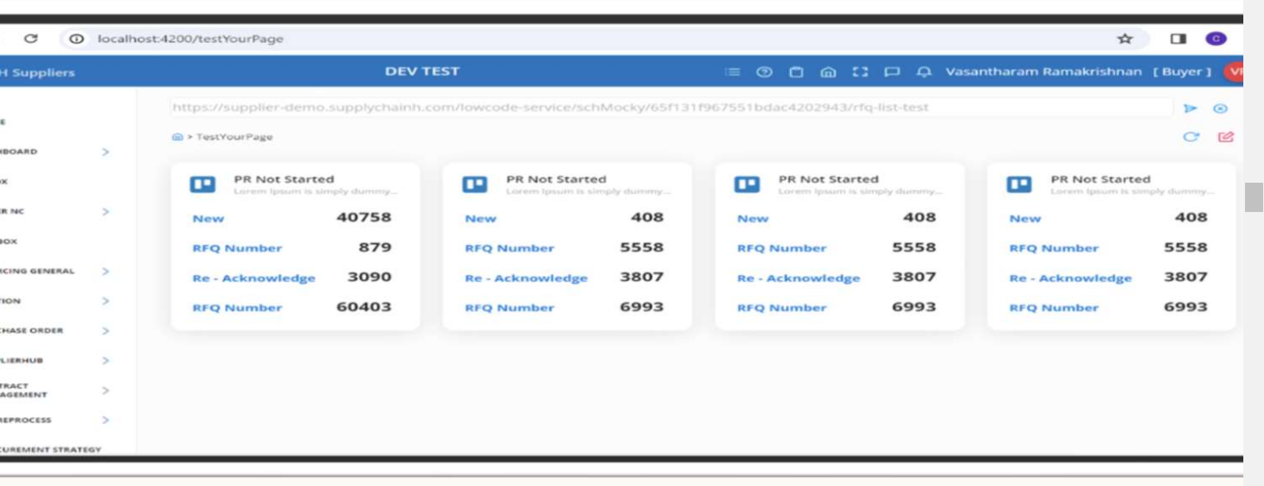
Platform Tasks
Kpi card Created Kpicard11 for Dashboard

Slide 10
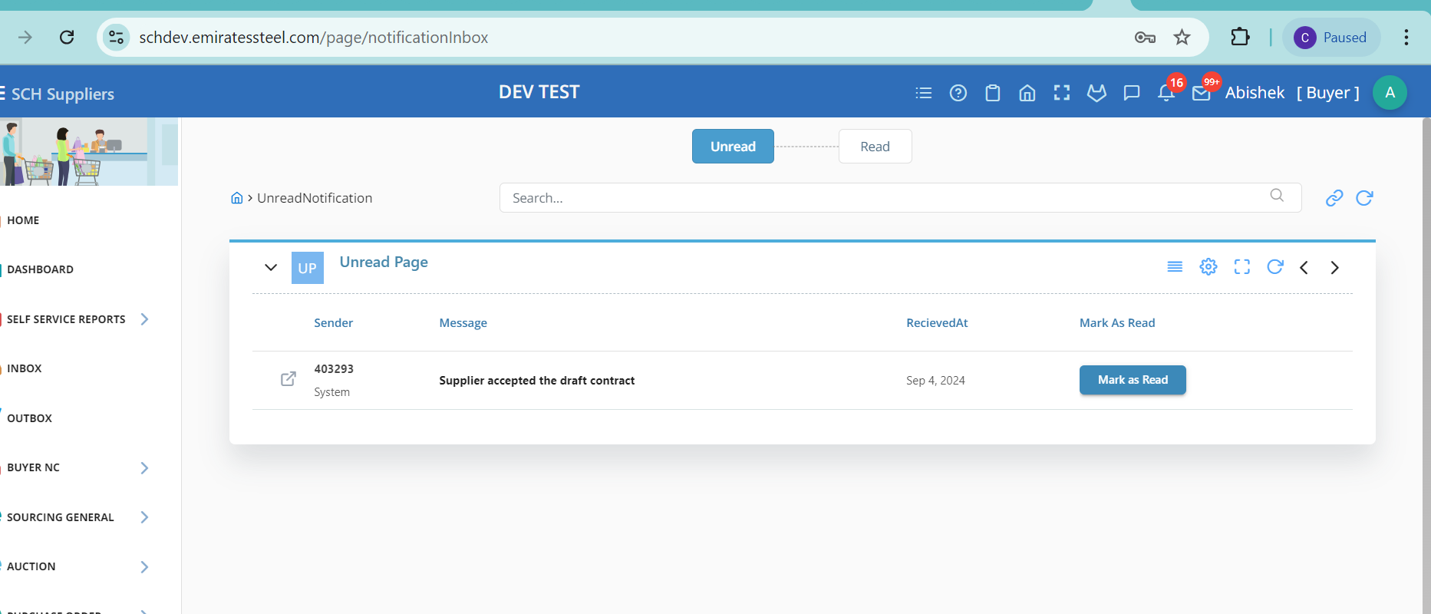
Platform Tasks
Notification Inbox

Slide 11
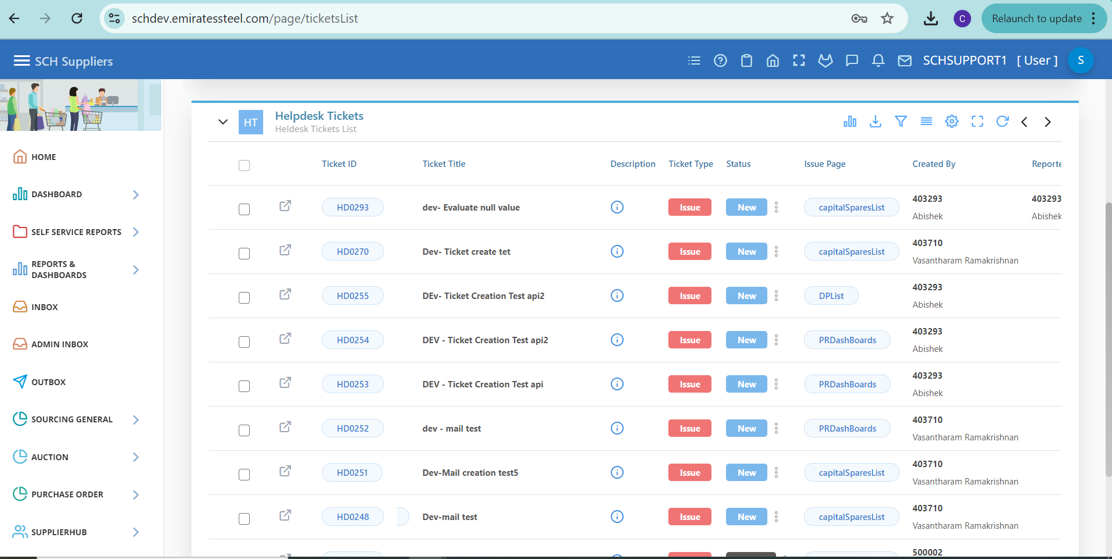
Helpdesk​ Involved in helpdesk enhancement ​and mail notification

Slide 12
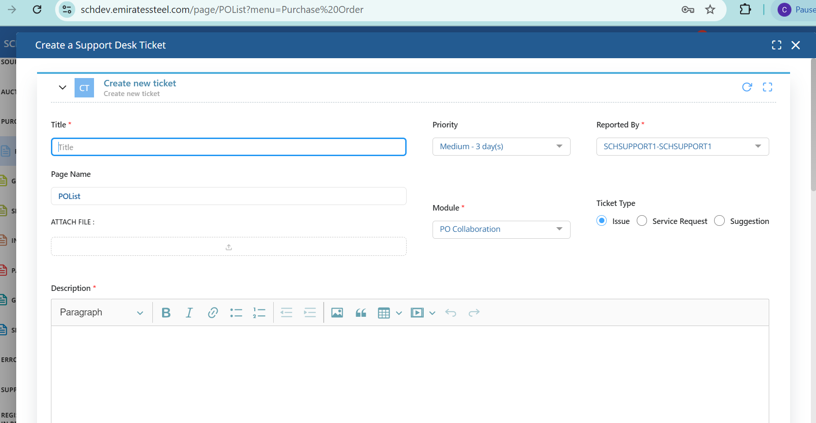

Slide 13
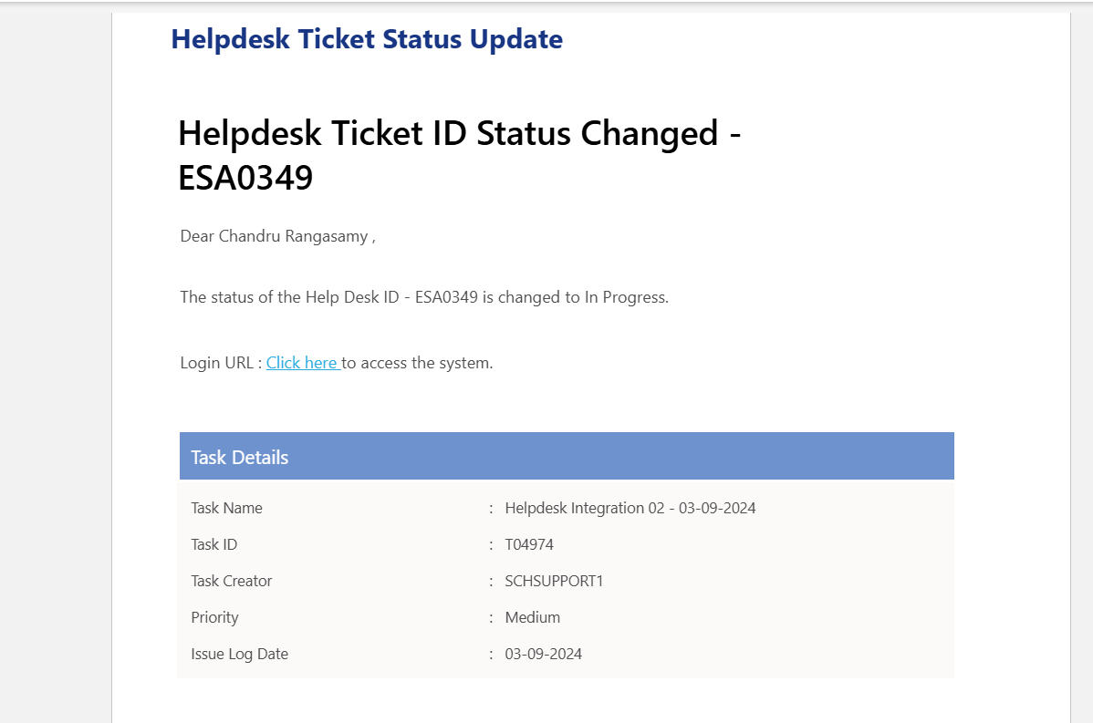
Helpdesk​ Helpdesk mail notification

Slide 14
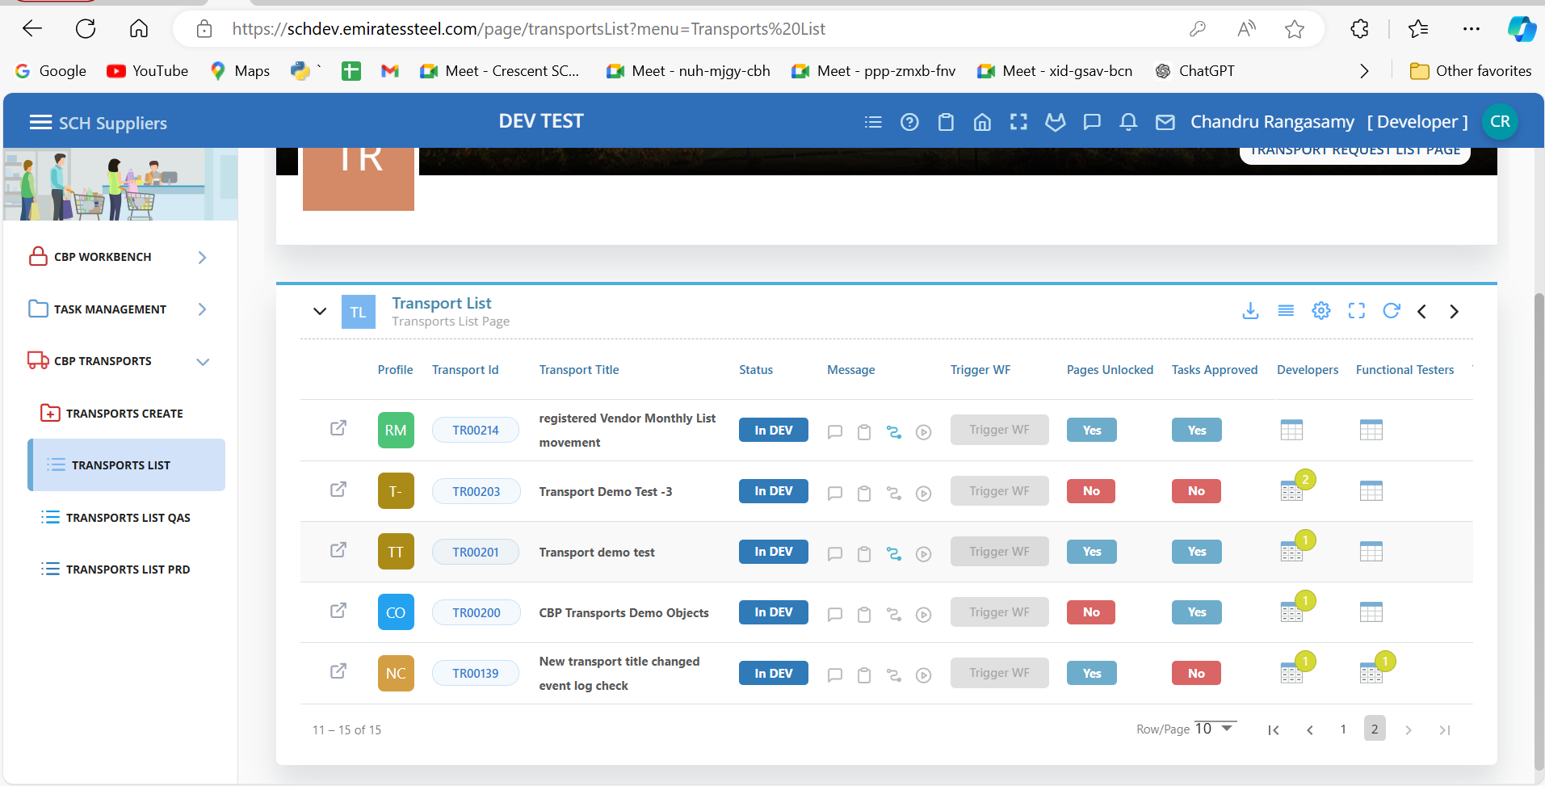
Platftrorm Tasks
Transport Automation Involved in enhancements

Slide 15
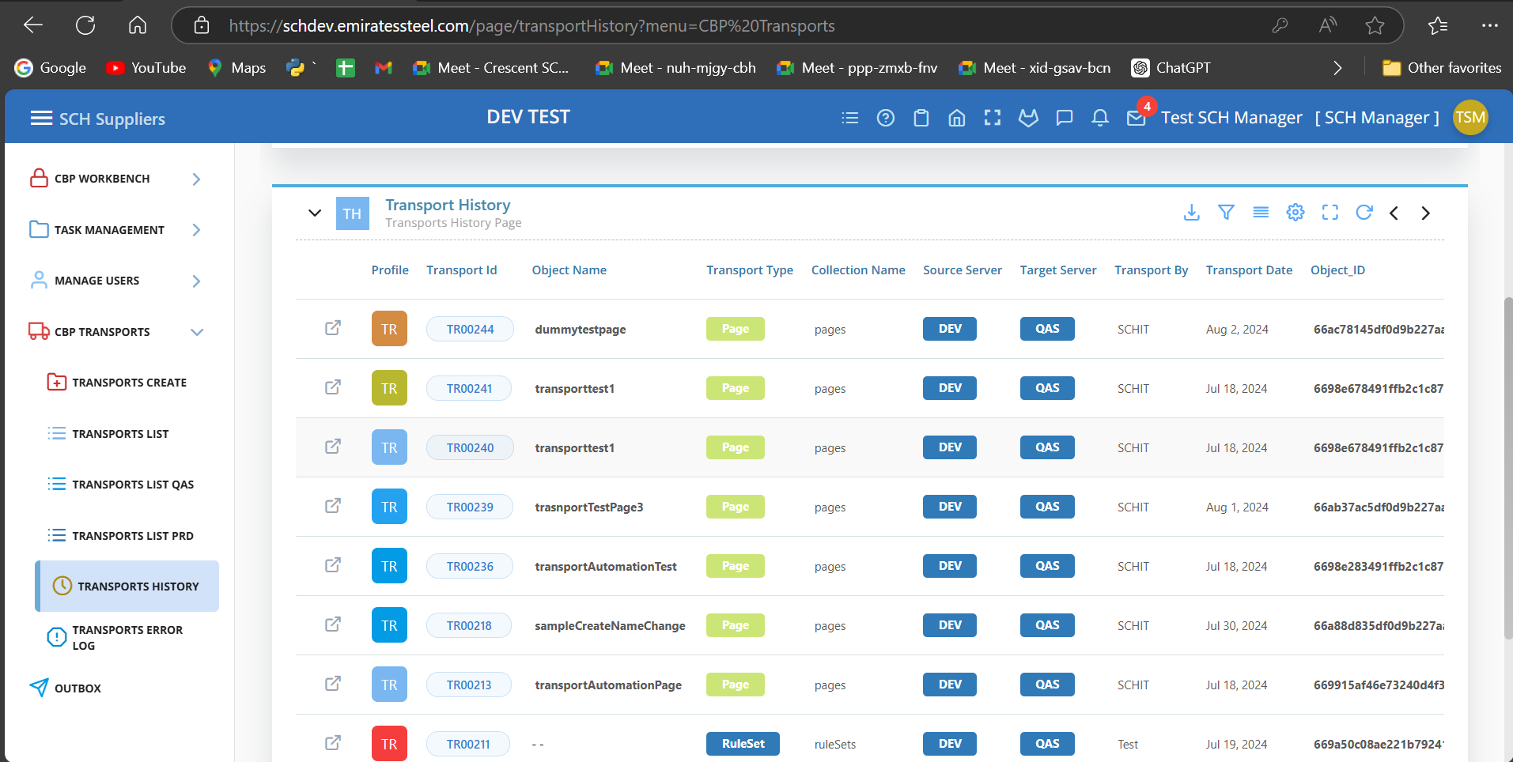
Transport History Page

Slide 16
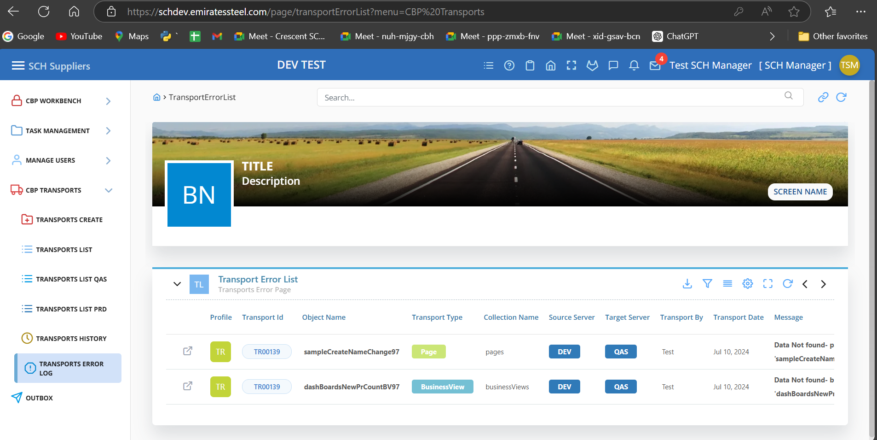
Transport Error Page

Slide 17
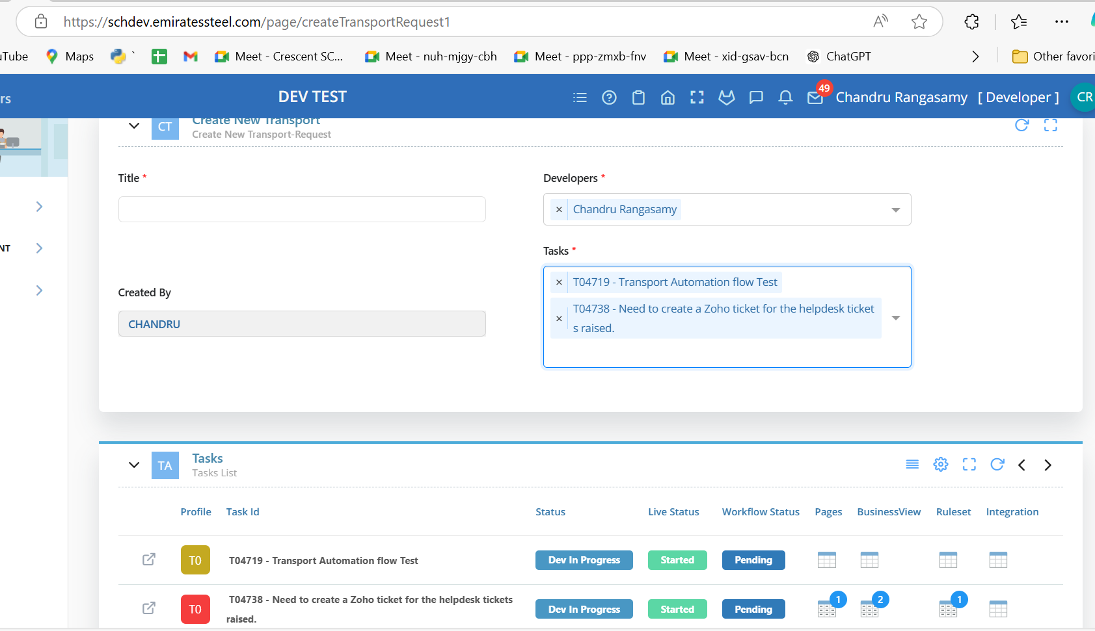
Created transport request page

Slide 18
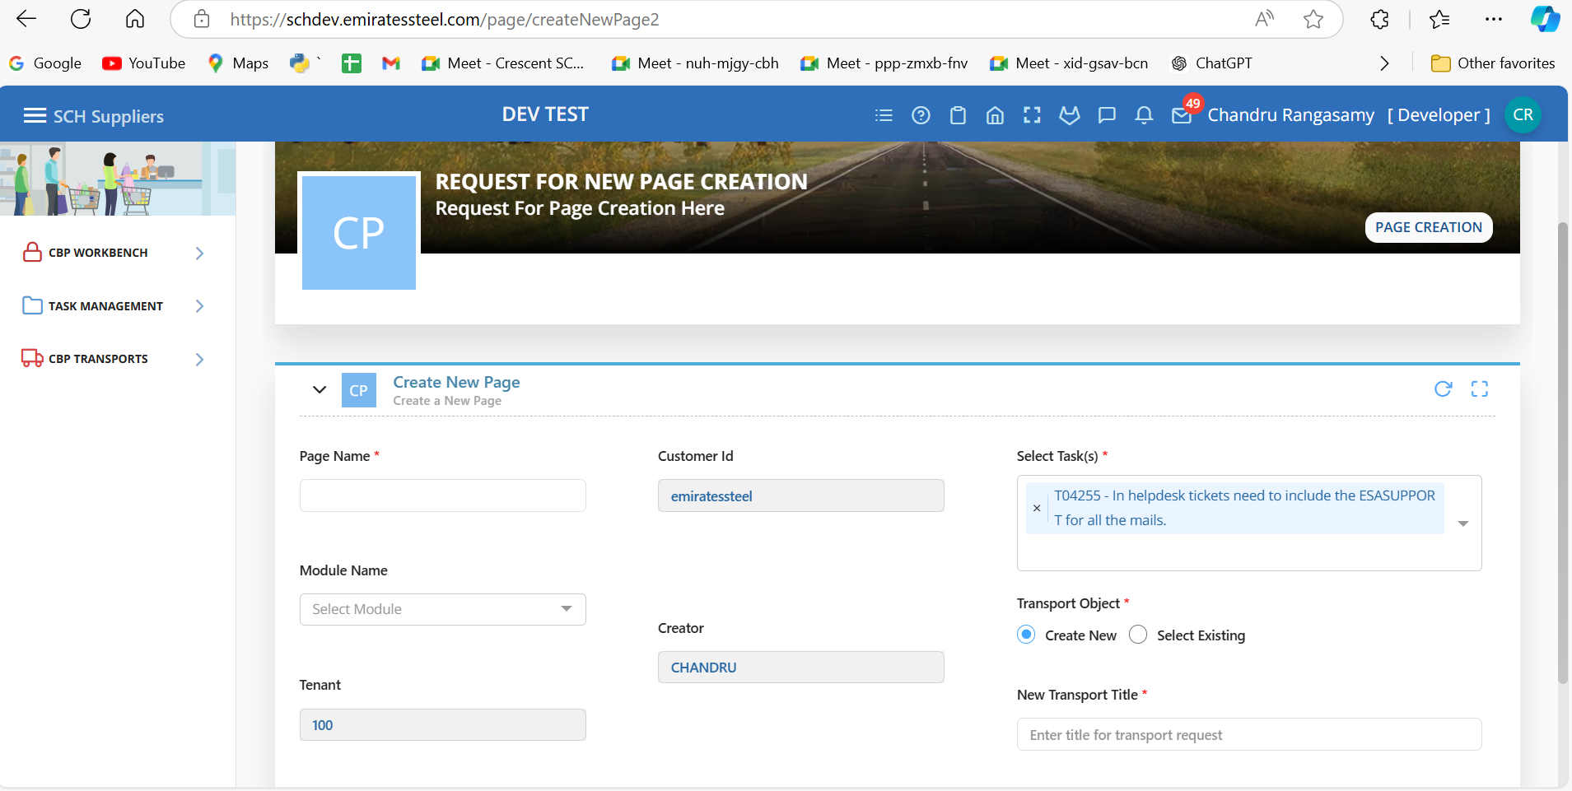
Page Creation task management

Slide 19
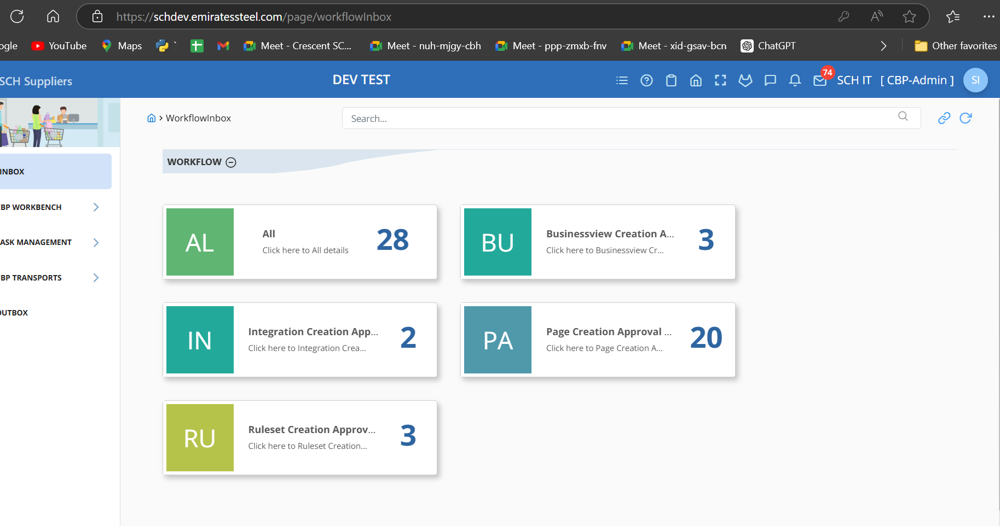
Created workflow for the task management & transport Automation

Slide 20
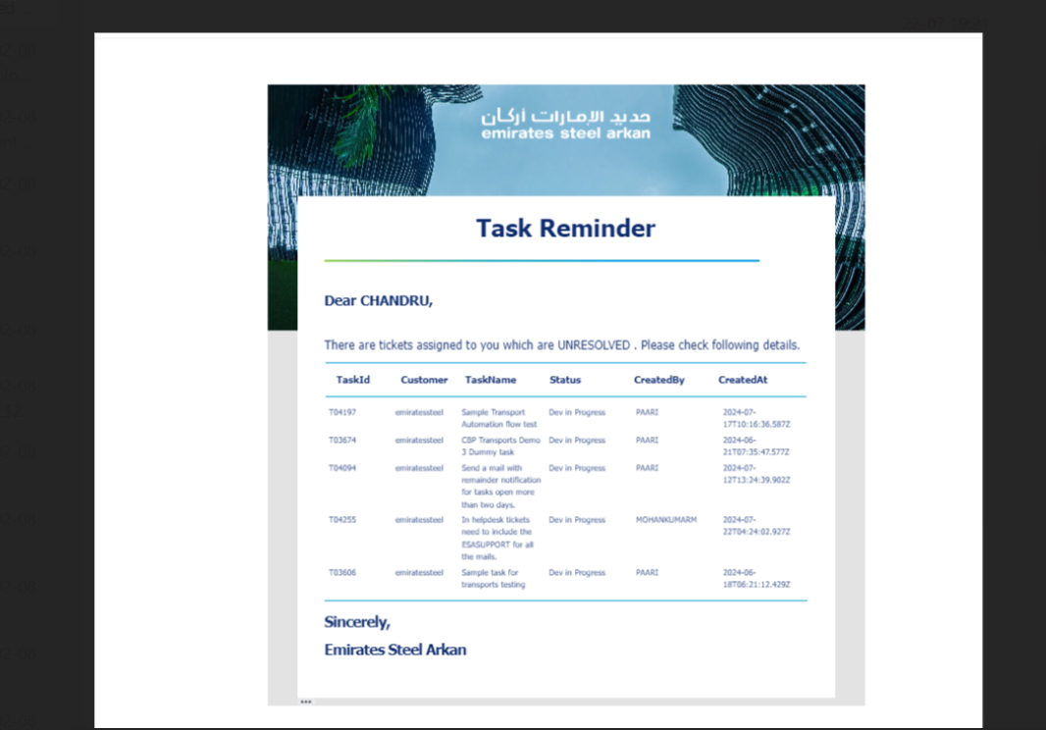
Task management Remainder Notification Involved in Task management remainder mail notification

Slide 21
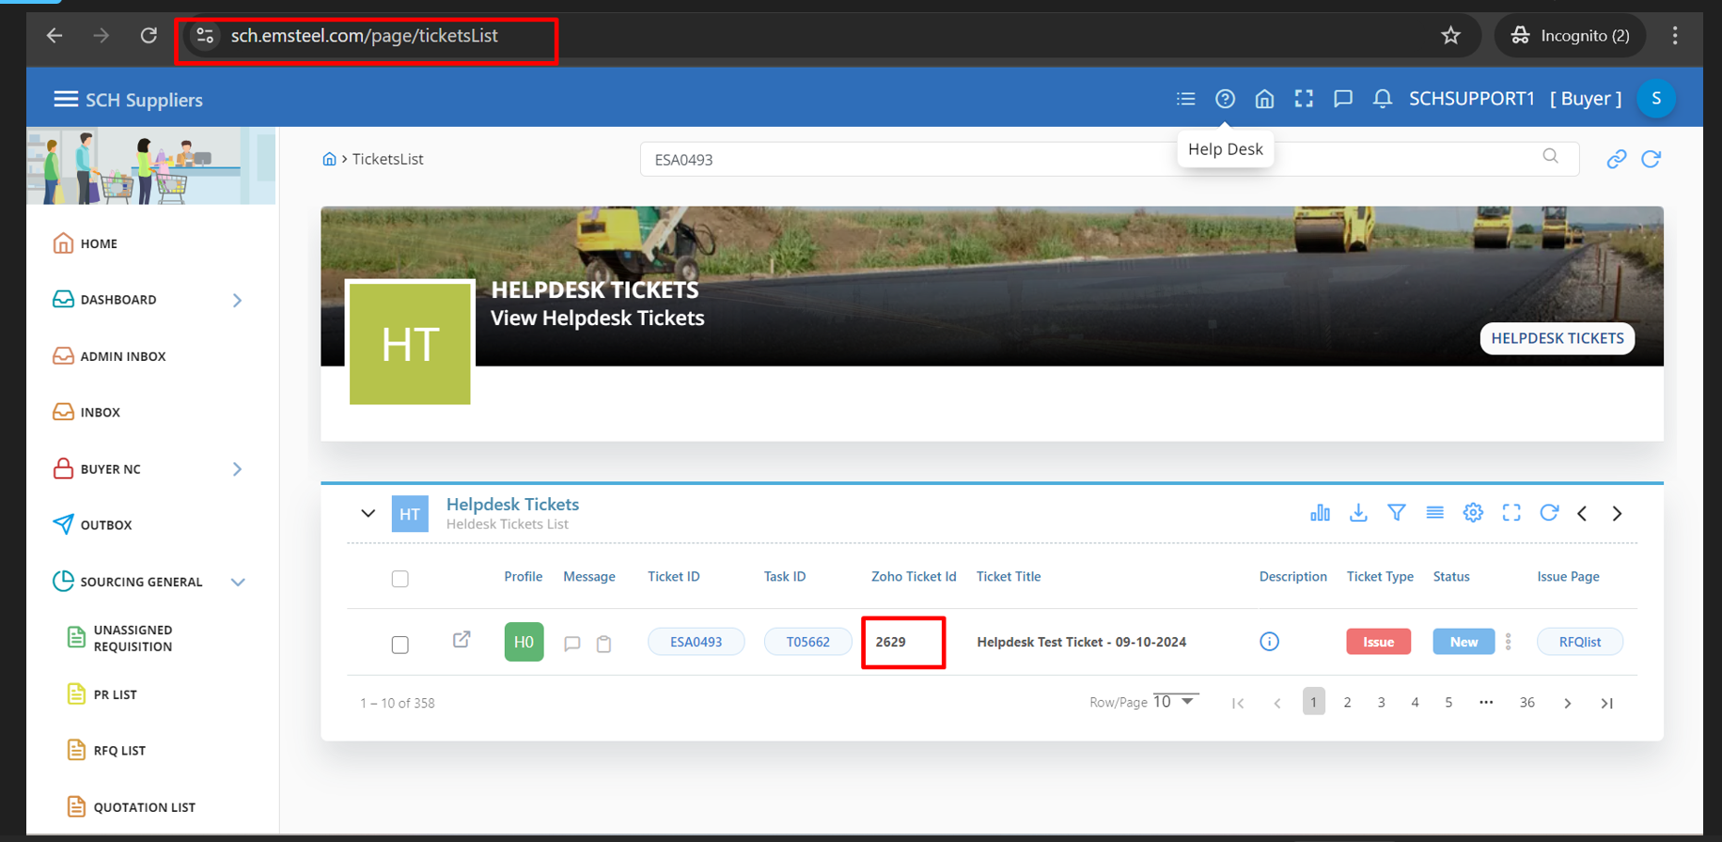
ZOHO TICKET When the helpdesk ticket raised need to create the zoho ticket

Slide 22
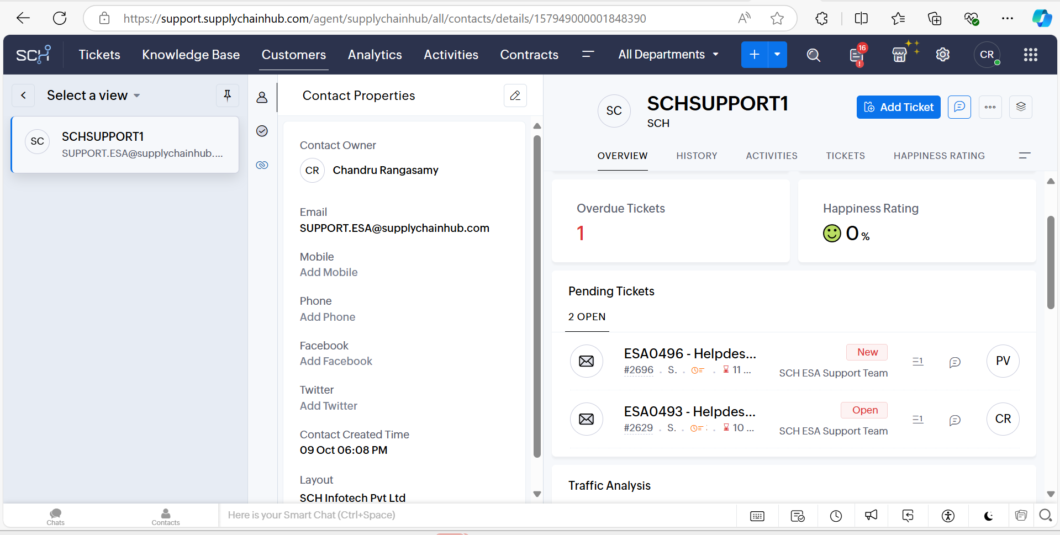

Slide 23
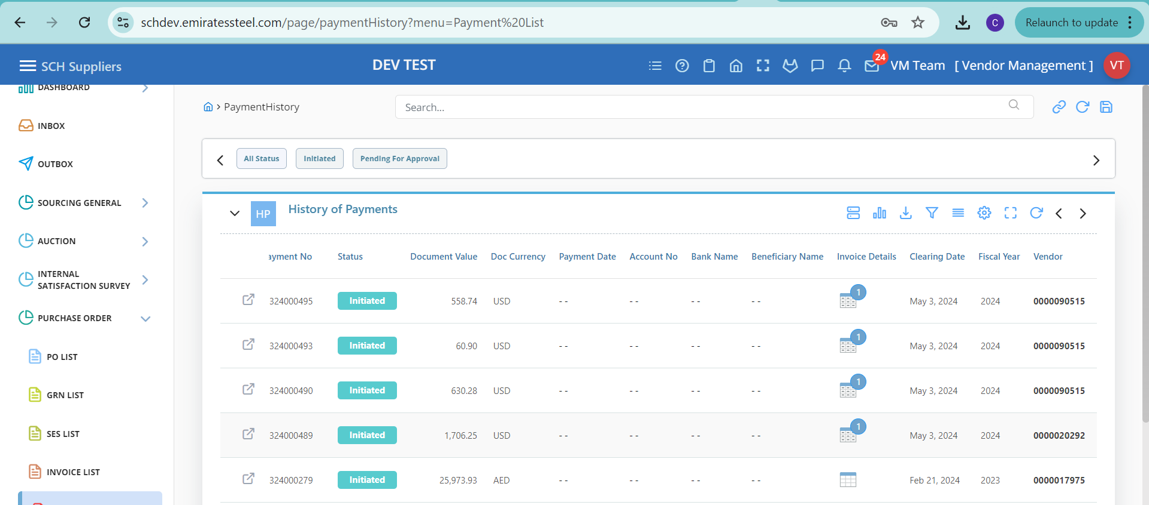
ESA Tasks
PO Collaboration Payment List page creation and involved in the enhancement changes.

Slide 24
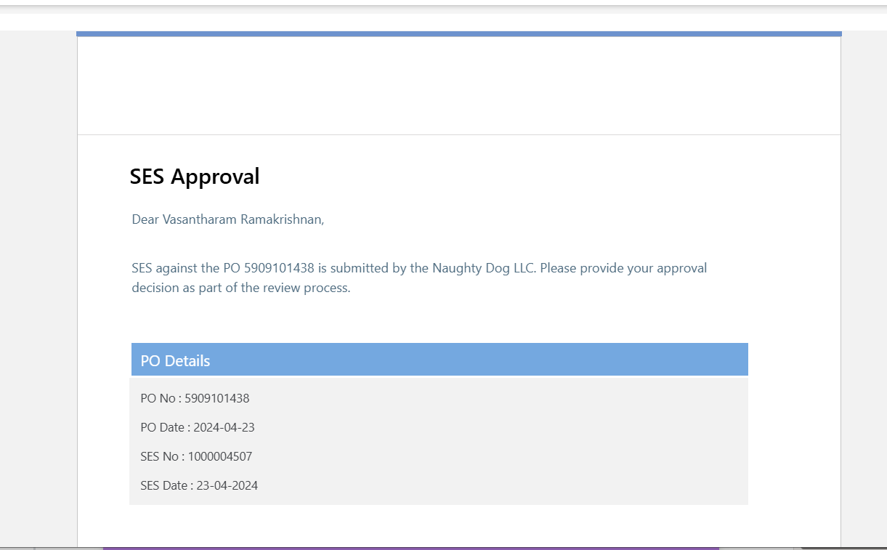

Slide 25
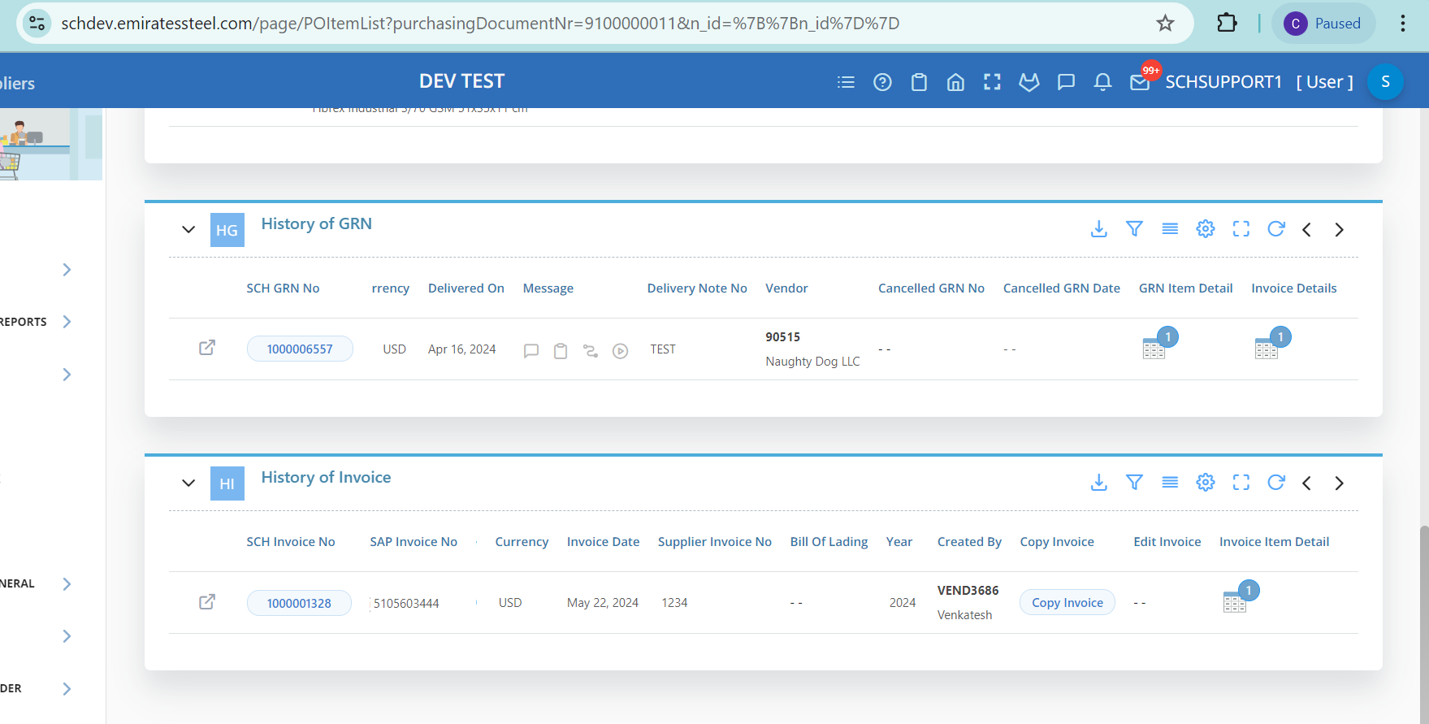

Slide 26
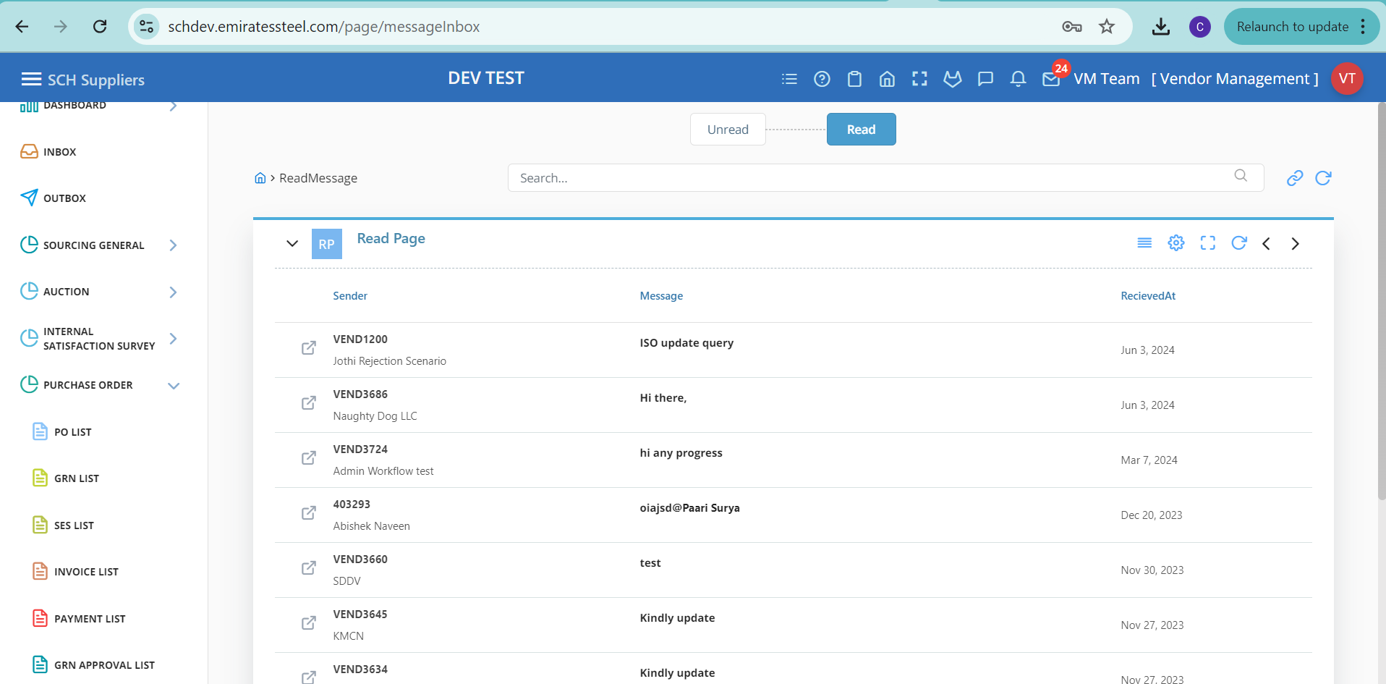
ESA Tasks
Vendor Management Involved in the message notification Inbox.

Slide 27
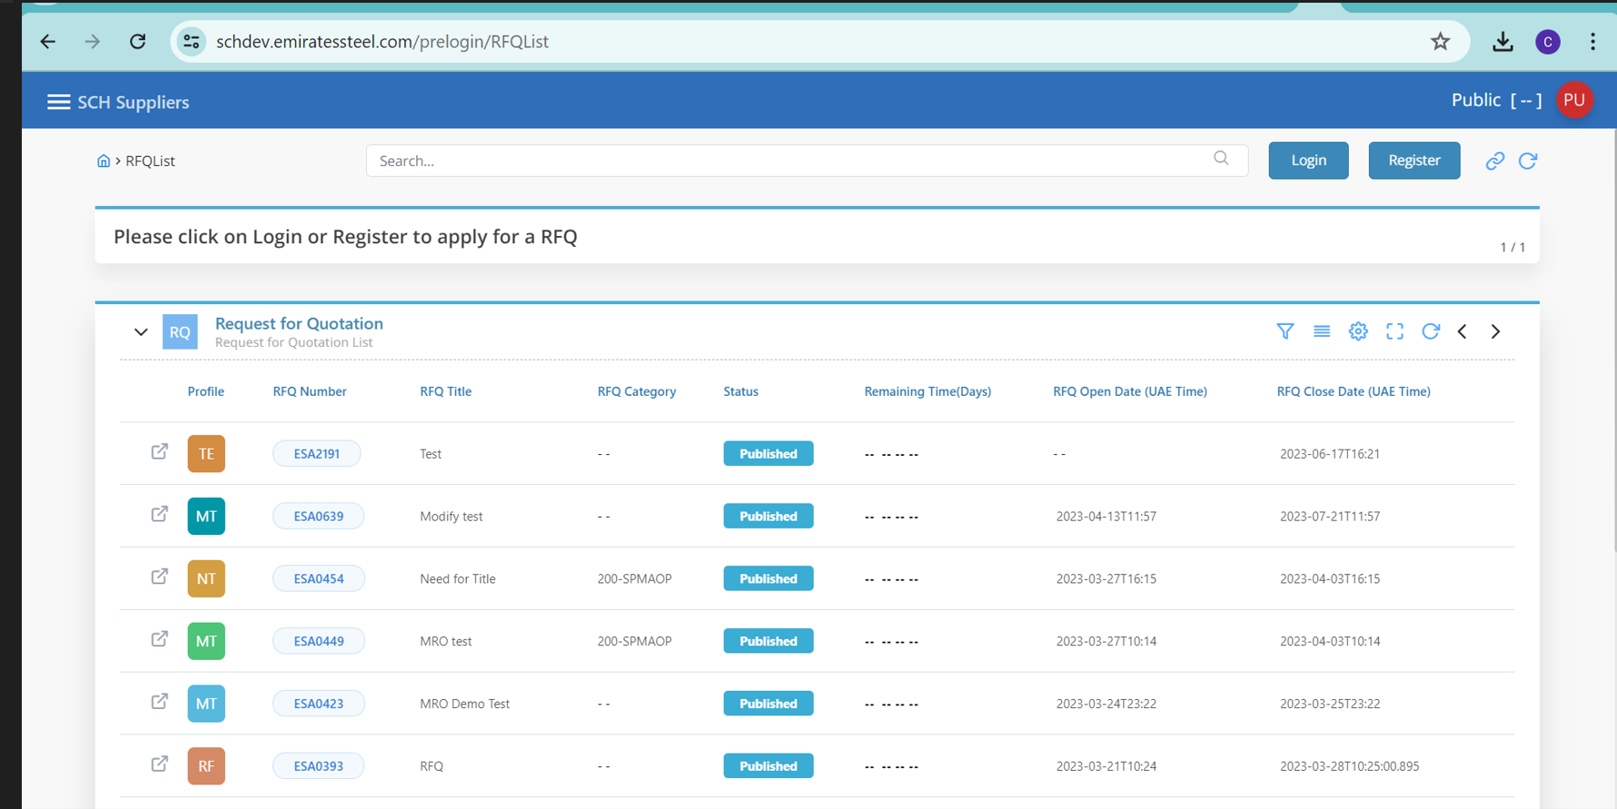
ESA Tasks
Involved in the RFQ pre login page and vendor creation.

Slide 28
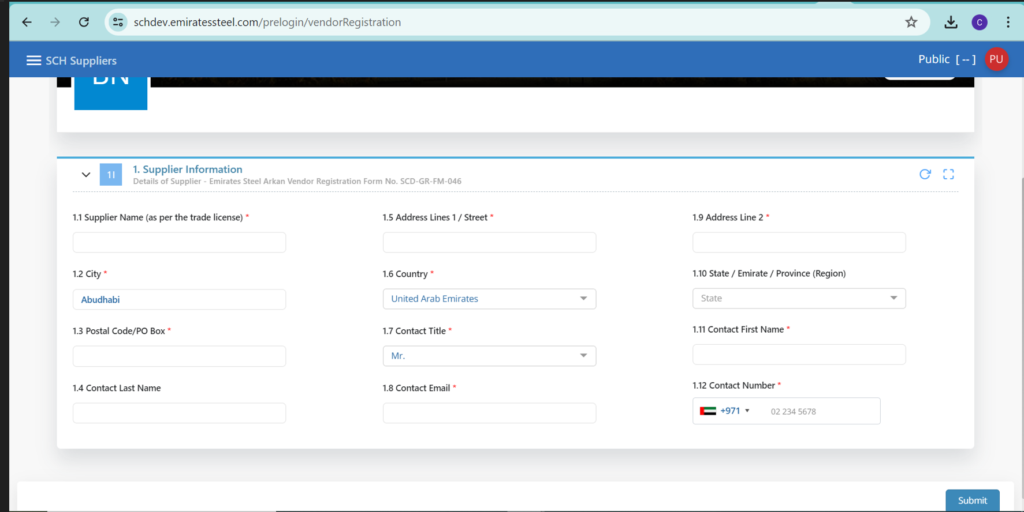

Slide 29
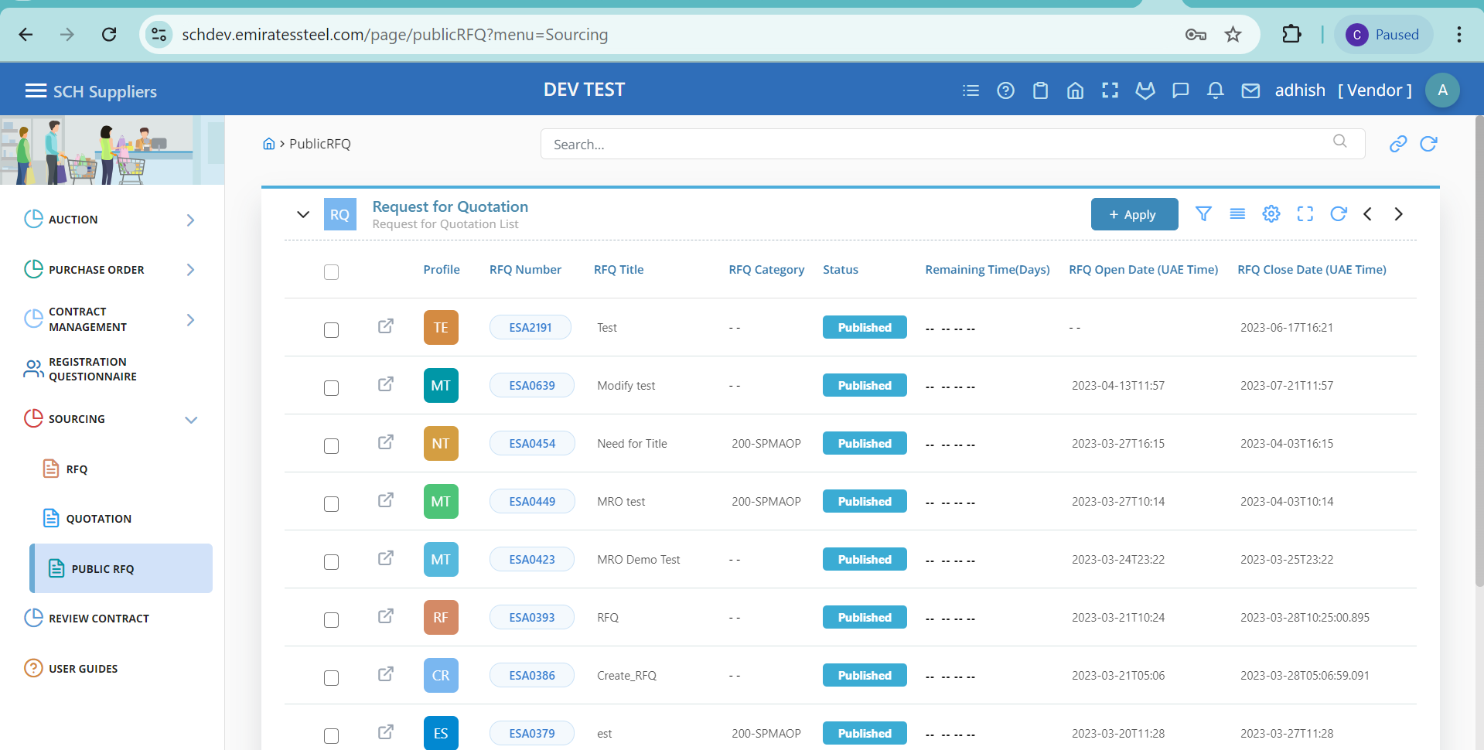

Slide 30
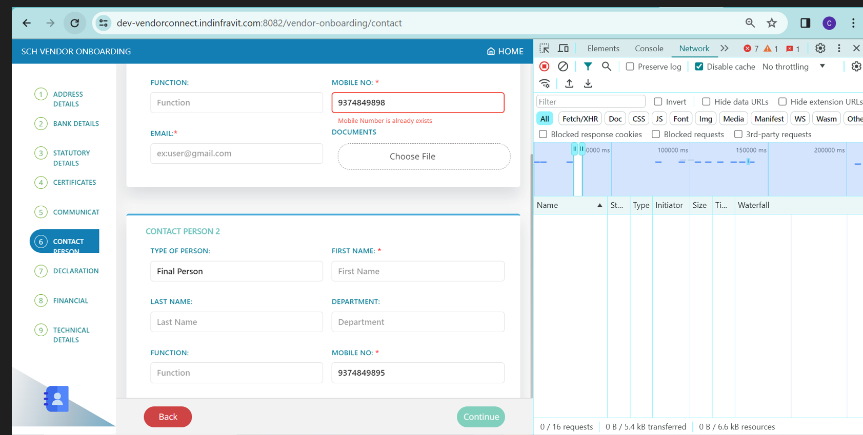
Infravit Tasks
Involved in the duplicate number validation and support tasks

Slide 31
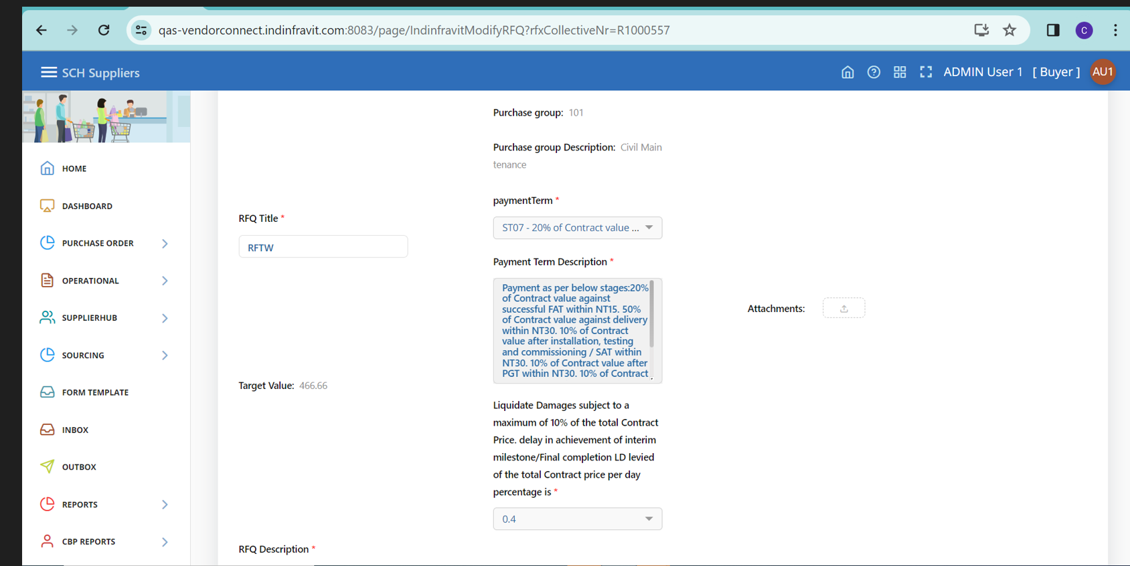

Slide 32
Modules Learned
Vendor Management
Po Collaboration
Rfq

Slide 33
Lesson Learned
Collaborated closely with cross-functional teams to gather requirements and drive development efforts, ensuring alignment between business needs and technical implementation.

Slide 34
Key Achievement
Po Collaboration tasks are moved to PRD
In Vendor Management tasks are moved to PRD
In Infravit completed tasks moved to PRD
In Platform Transport automation enhancement tasks are completed.

Slide 35
Planned Activities
When the helpdesk ticket raised need to create integration between the ESA & ZOHO.
Implemented helpdesk in NFIL & Crescent
In CBP transport automation planned to work on the second phase and also to involve in the platform tasks.

Slide 36
Rating
Points | Ratings
Maturity | 4
Intellect | 4
Coding skills | 4
Willing to learn | 5
Willing to support beyond regular hours | 3.5
Reachable any time even on holidays | 4
Available anytime for emergencies | 4
Ability to understand requirements | 4
Ability to solve the requirement with own logic DS and algorithms | 4
Quick response to all queries and messages sent by colleague's customers or managers | 4

Slide 37
Rating
Points | Ratings
Timely delivery of tasks | 4
Following good development release process to ensure high quality output | 4.5
Helping own team members | 5
Helping other team | 4
Passionate for product development | 5
passionate for own company growth | 5
Ambitious to become a future company leader or a next level team leader. | 4

Slide 38
THANK YOU..!

